Slide 1

User Guide
v1.3

Slide 2
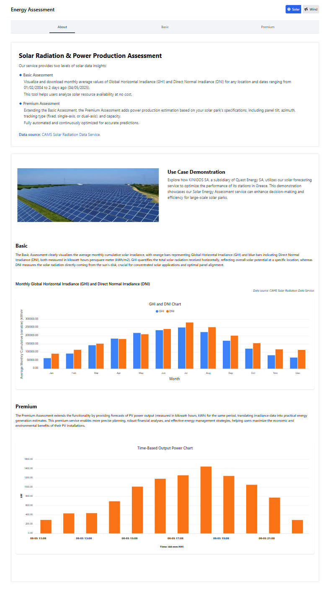
Under the About tab, the interface explains the two core assessment types
The Basic Assessment allows users to visualize and download monthly average values of Global Horizontal Irradiance (GHI) and Direct Normal Irradiance (DNI) for any geographic location.
To demonstrate a real-world application and a chart that visually compares and includes a Use Case Demonstration.
The Premium Assessment builds on the Basic version by incorporating power production estimations. It considers solar park specifications like panel tilt, azimuth angle, and the type of solar tracking system (fixed, single-axis, or dual-axis), and is fully automated for accurate forecasting.
This section features an image of a solar park and describes how KINIGOS SA, a subsidiary of Quest Energy SA, uses this forecasting tool to improve the performance of its solar stations in Greece. The case study emphasizes how the service enhances efficiency and supports data-driven decisions for large-scale solar operations.

Slide 3
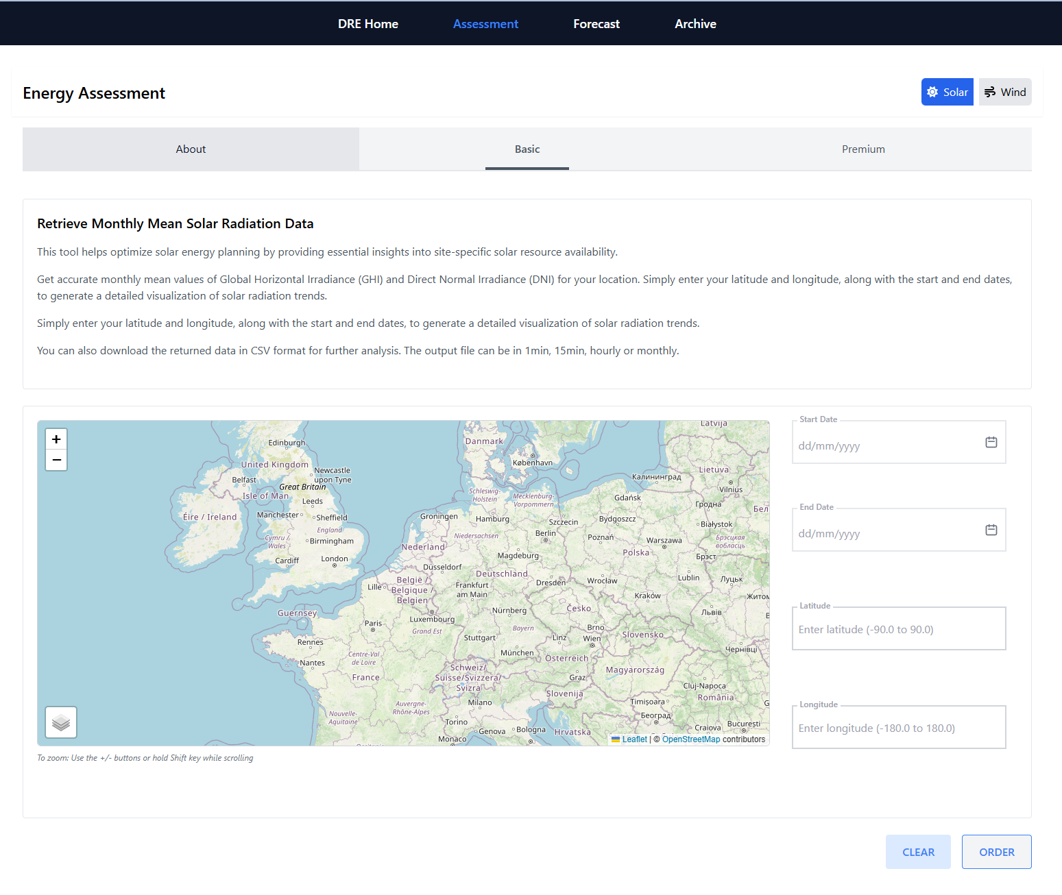
The Basic tab of the Solar Energy Assessment tool lets users retrieve monthly solar radiation data to support site-specific solar energy planning.
By entering a start and end date, plus latitude and longitude, users can generate detailed data on GHI and DNI for any location. An interactive map helps users select coordinates easily.
After inputting the data, click “ORDER” to generate the output, which is downloadable as a CSV file in 1-minute, 15-minute, hourly, or monthly intervals.
Use the “CLEAR” button to reset all fields. The map supports zooming for precise location targeting.

Slide 4
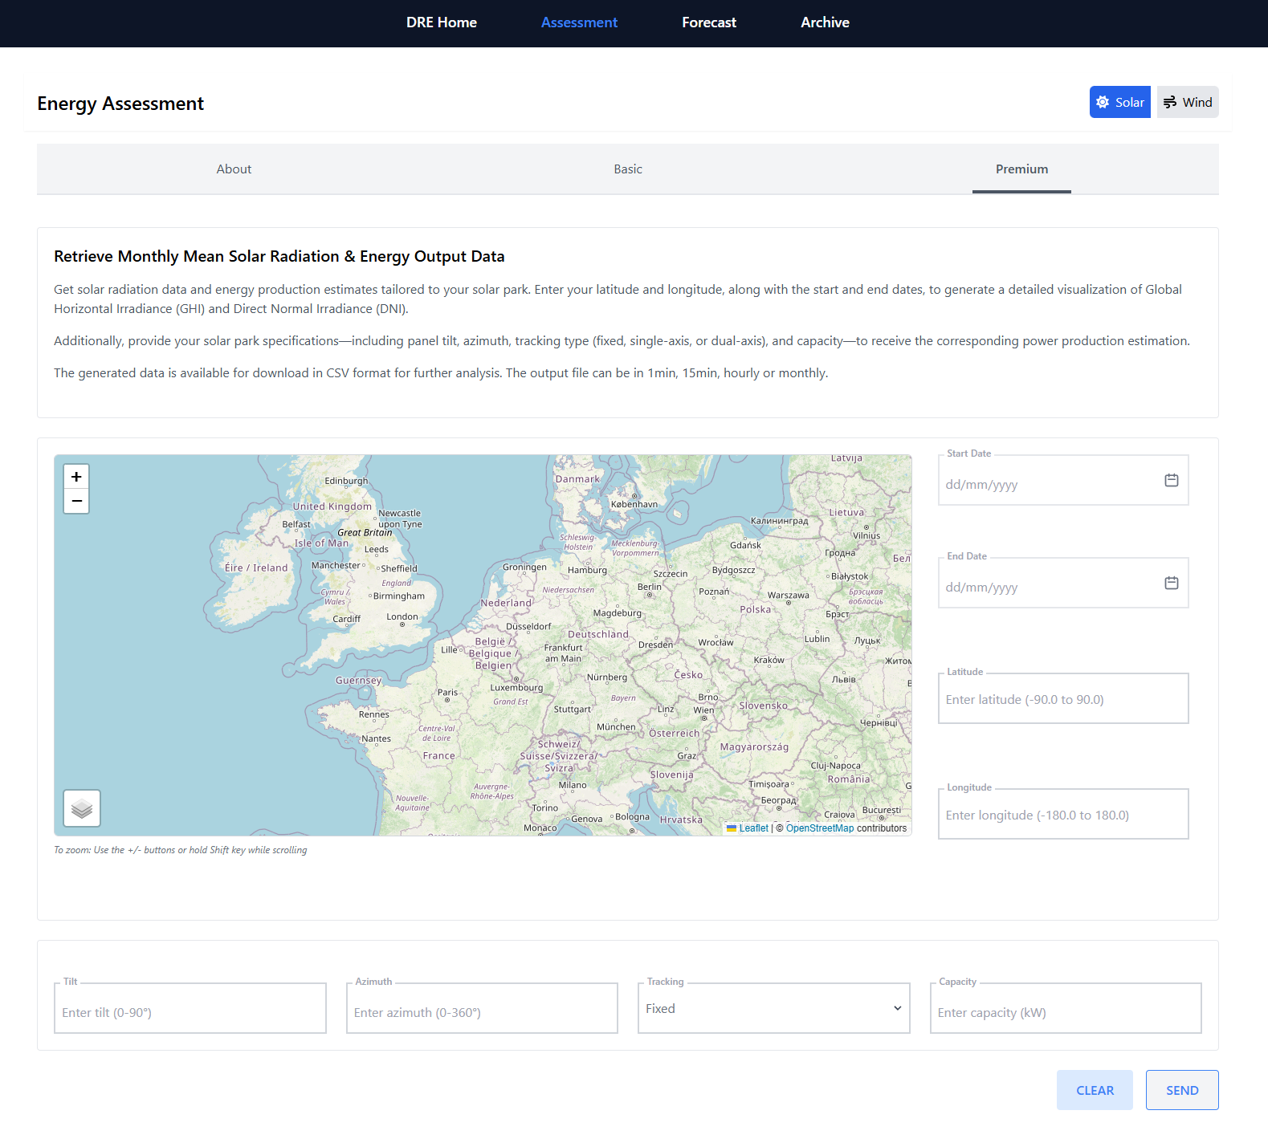
The Premium section allows users to generate advanced solar radiation and energy output estimates customized for solar park configurations.
To use it, users must enter a start and end date, as well as the latitude and longitude of the site. A map is provided for geographic reference and zoom functionality to help locate the site more accurately.
In addition to location and date, users must input key system parameters including panel tilt (0–90°), azimuth (0–360°), tracking type (fixed, single-axis, or dual-axis), and capacity (in kW). These inputs are used to calculate a detailed estimate of solar power production.
Once all fields are complete, clicking “SEND” generates a downloadable CSV file containing solar radiation and production data at resolutions of 1-minute, 15-minute, hourly, or monthly.
The “CLEAR” button resets the form to start over.

Slide 5
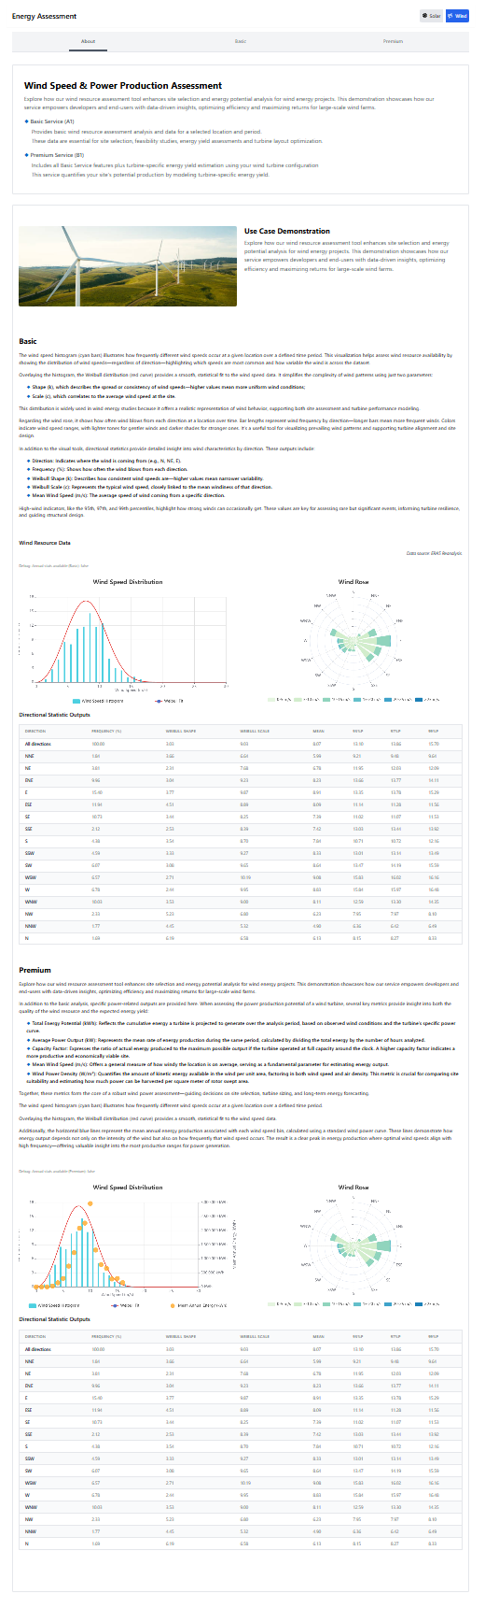
This section of the Energy Assessment tool analyzes site-specific wind data to estimate energy production potential, aiding site selection, turbine layout, and yield forecasts for Basic and Premium services.
The Basic Service provides access to wind speed statistics for a selected location and time period. It includes directional statistics, Weibull distribution, and wind rose, aiding in feasibility studies and turbine siting.
A Use Case Demonstration illustrates how this tool supports wind project planning, showing how developers can optimize site design and energy returns through data-driven analysis.
Beneath the charts is a Directional Statistics Outputs table. It lists detailed wind data per direction, including frequency (%), Weibull shape and scale values, mean speed, and percentiles. This data supports in-depth energy yield modeling and performance forecasting for wind turbines.
In the lower half of the page, users can view Wind Resource Data outputs, including a Wind Speed histogram with its fitted Weibull distribution and a Wind Rose. These visualizations illustrate the variability of wind speed and the frequency of wind directions across different speed ranges, providing valuable insights into the local wind resource characteristics.
The Premium Service builds on the Basic offering by incorporating turbine-specific modeling for energy production estimates based on actual wind turbine configurations.

Slide 6
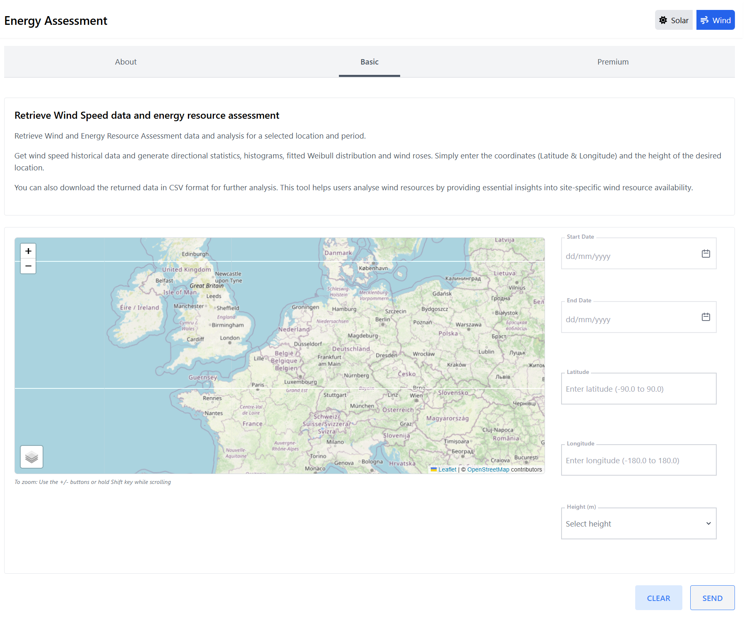
The Basic tab under the Wind mode of the Energy Assessment tool enables users to assess wind speed and energy resource availability at a selected location and time period.
Users simply input the start and end dates, latitude and longitude, and measurement height (in meters) of the desired location. An interactive map helps pinpoint coordinates visually and supports zooming for precision.
This tool provides access to historical wind speed data and allows generation of advanced visualizations such as directional statistics, histograms, fitted Weibull distributions, and wind roses.
These outputs are useful for site-specific wind energy analysis.
After entering all required details, users can click “SEND” to generate results, which are available as CSV downloads for further analysis.
The “CLEAR” button resets all fields for a new search.

Slide 7
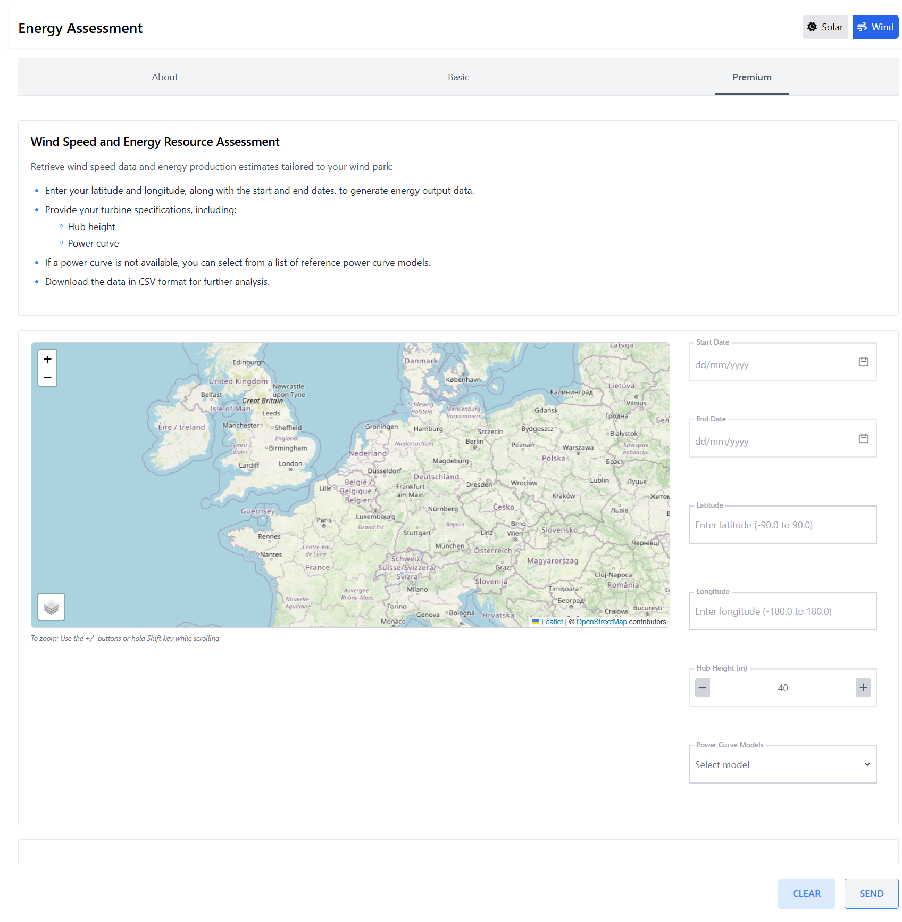
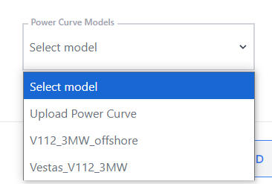
The Premium section under the Wind mode of the Energy Assessment tool enables users to generate tailored wind energy production estimates based on specific wind park configurations.
To begin, users input the start and end dates, along with the latitude and longitude of their site. An interactive map assists with visual location selection and zooming for precision.
In addition to location and time, users are required to specify turbine details, including the hub height (in meters) and a power curve model. If the exact power curve is not available, users can select from a list of standard reference models provided in the dropdown menu.
After entering all information, clicking “SEND” processes the request and generates downloadable results in CSV format for further analysis. These results provide insights into wind energy output tailored to the user's configuration.
The “CLEAR” button resets the form to allow for a new input.

Slide 8
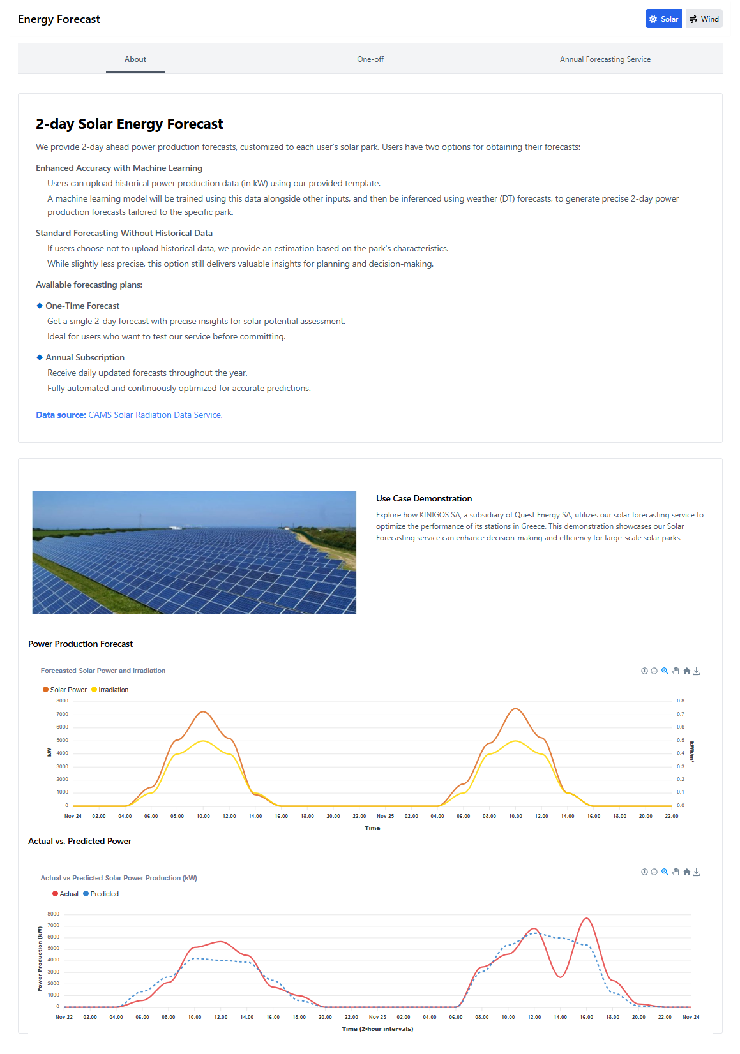
Under the About tab, the interface explains the two core forecasting types
Machine Learning Forecasting (with Uploaded Data) Ideal for users with historical production data. By uploading data in the platform’s Excel format, the system:
Learns location-specific patterns
Adjusts for anomalies (e.g., shading, tilt, inverter issues)
Delivers personalized forecasts combining past trends and real-time weather
Standard Forecasting (No Upload) Ideal for new users or sites without historical data. Uses location, weather averages, and satellite info to provide instant, planning-ready forecasts—less precise but still valuable
One-Time Forecast Ideal for feasibility studies, simulations, comparisons, or validating internal forecasts.
Annual Subscription Best for daily use and long-term planning, offering automated, hands-free forecasting integrated into workflows
Use Case Demonstration
A real-world example is provided:
KINIGOS SA, a Greek solar energy company, demonstrates how this tool improves efficiency for large-scale solar parks.
Presents:
Power Production Forecast
Displays forecasted solar power output and irradiation levels over two days.
Actual vs. Predicted Power
Compare actual power output with system forecasts
Graph Controls (top right corner of each diagram)

Slide 9
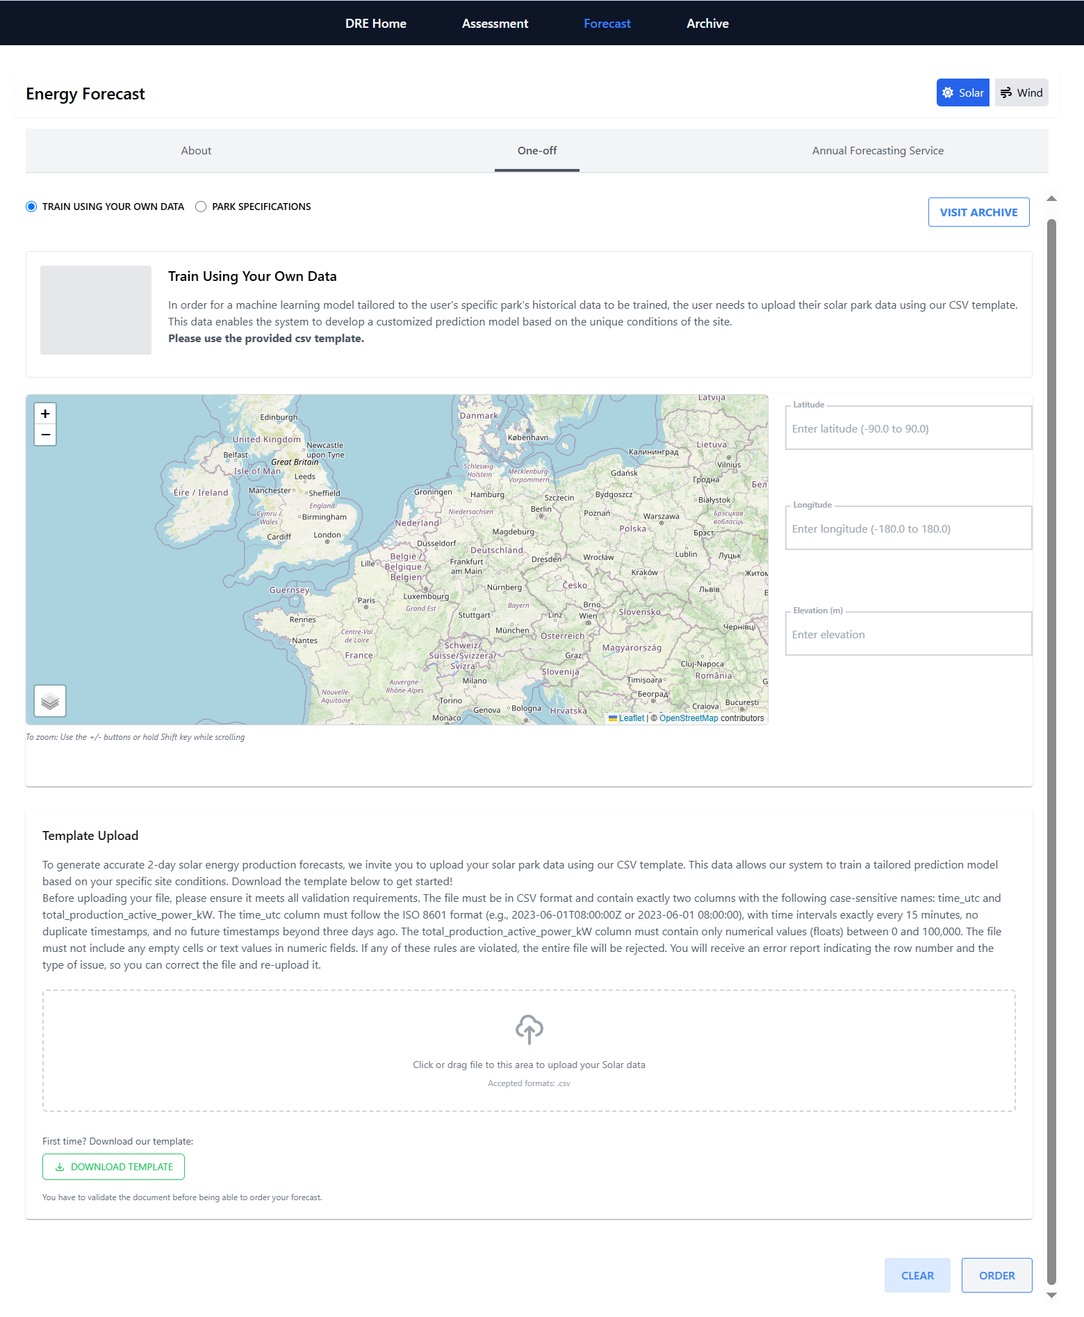
One-Off Forecast: Train Using Your Own Data
This section allows users to generate a personalized 2-day solar energy forecast using historical solar production data from their own park. By uploading a properly formatted CSV file, the platform uses machine learning to build a prediction model tailored to the specific site conditions.
Visit Archive to see your forecasting orders
Provide Location Details
Users must input basic geographical information to geolocate their solar park, which is critical for combining weather inputs with production history.
Upload Training Data
To enable a tailored machine learning forecast, you must upload a properly formatted CSV file using the drag-and-drop area labeled.
CSV Format Requirements
The uploaded file must follow the provided instructions
Before uploading, validate your data using the Validate Template button to avoid interruptions.
Clear – Resets the form and removes uploaded data or entered values.
Order – Finalizes the submission and triggers the forecasting process once your data and site details are correctly filled in.
After submission, you will receive a custom forecast generated from your data, combined with weather predictions for the park’s location. This will be displayed as graphs and downloadable results in the Archive.
Download Template Use this to get the required CSV format pre-structured with correct column headers and formatting.

Slide 10
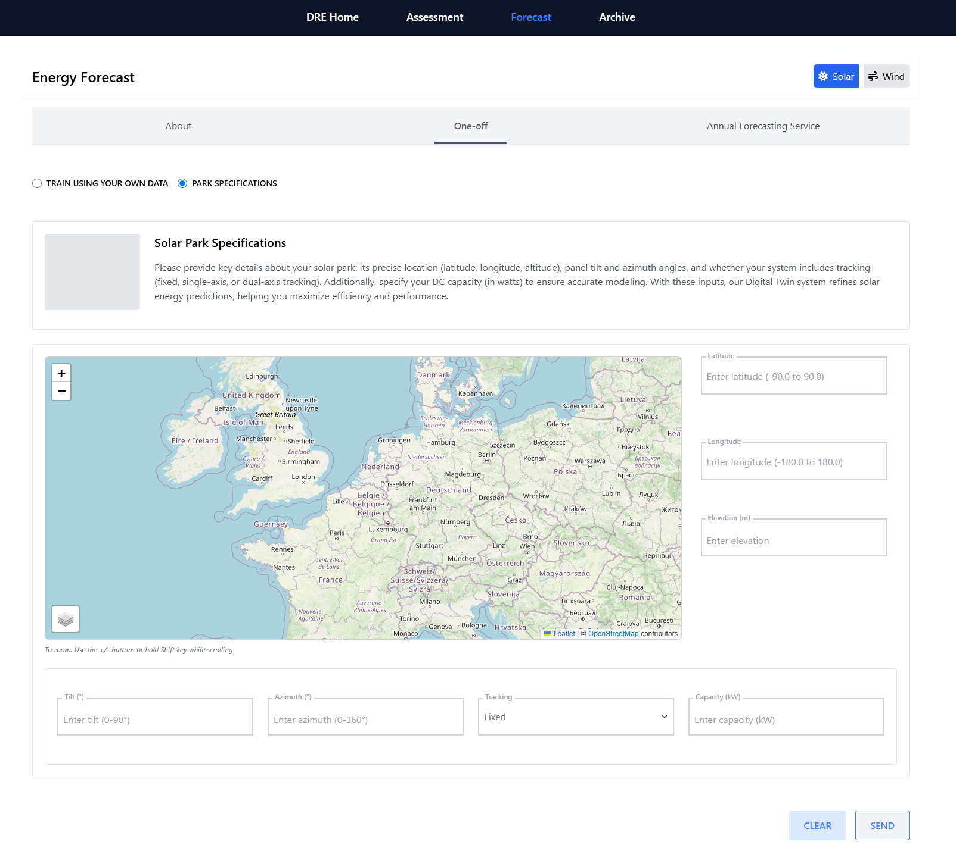
The Energy Forecast – One-off enables users to input essential information about a solar park for one-time energy forecasting.
Users can utilize the interactive map to visually locate their site, then enter the latitude, longitude, and elevation on the right-hand side to specify the exact location. Below the map, they provide the panel tilt and azimuth angles, select a tracking type (fixed, single-axis, or dual-axis), and input the DC capacity in kilowatts.
Once all fields are completed, users can click SEND to generate the forecast or CLEAR to reset the form. Accurate entries are key to producing reliable and optimized results.

Slide 11
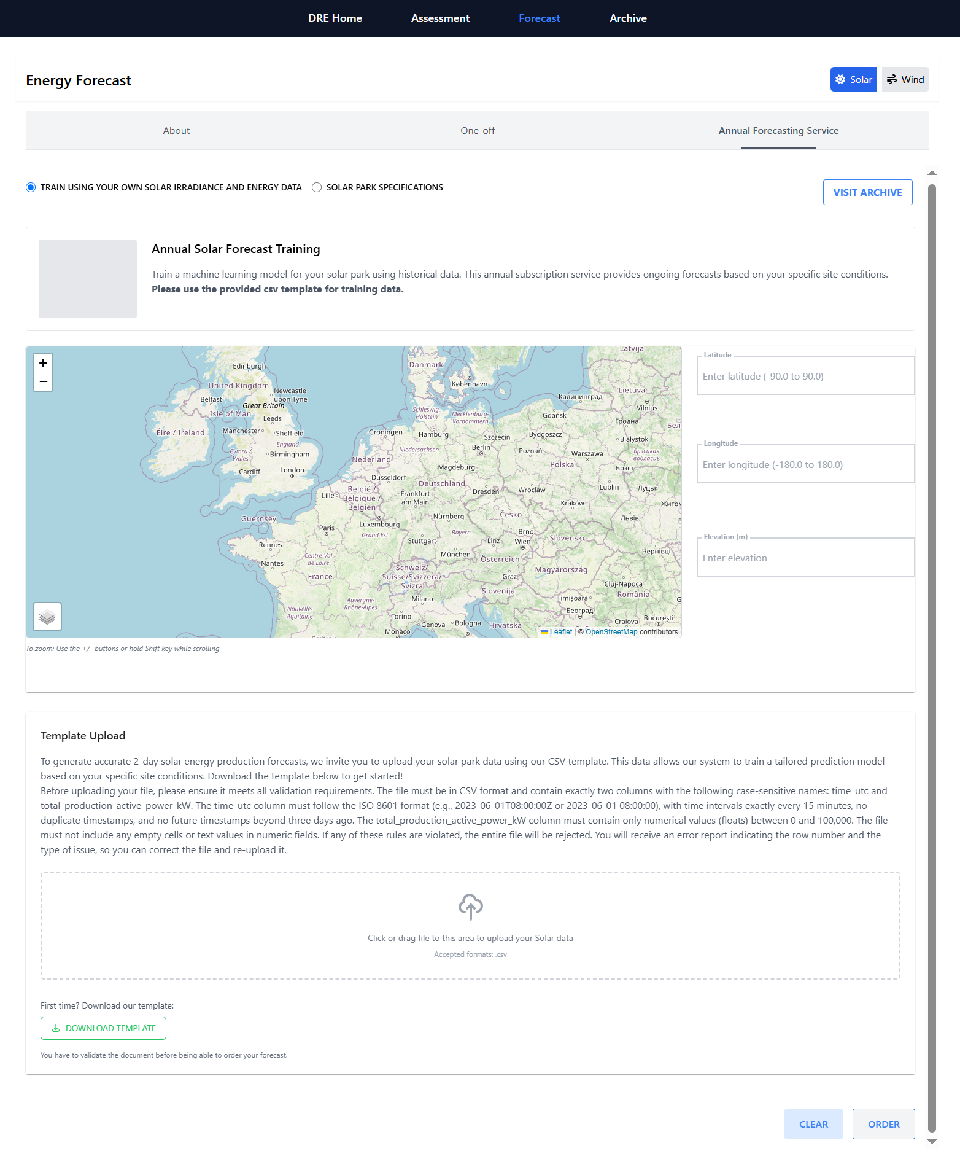
The Annual Solar Forecast Training section allows users to train a machine learning model for their solar park using historical data. This service provides ongoing, site-specific energy forecasts and requires users to upload solar irradiance and energy data via a standardized CSV template.
To begin, users enter the latitude, longitude, and elevation of their solar park on the right-hand panel, using the map for visual reference. Below the map, the Template Upload section guides users through the process of uploading their historical data. The CSV must include two columns—time_utc and total_production_active_power_kW—with values formatted precisely according to the instructions.
Once ready, users drag and drop the file into the upload area, then click ORDER to initiate the training process. Or CLEAR to create a new.
The platform provides tools to download and validate the template before upload. Only validated data can be used to generate forecasts.

Slide 12
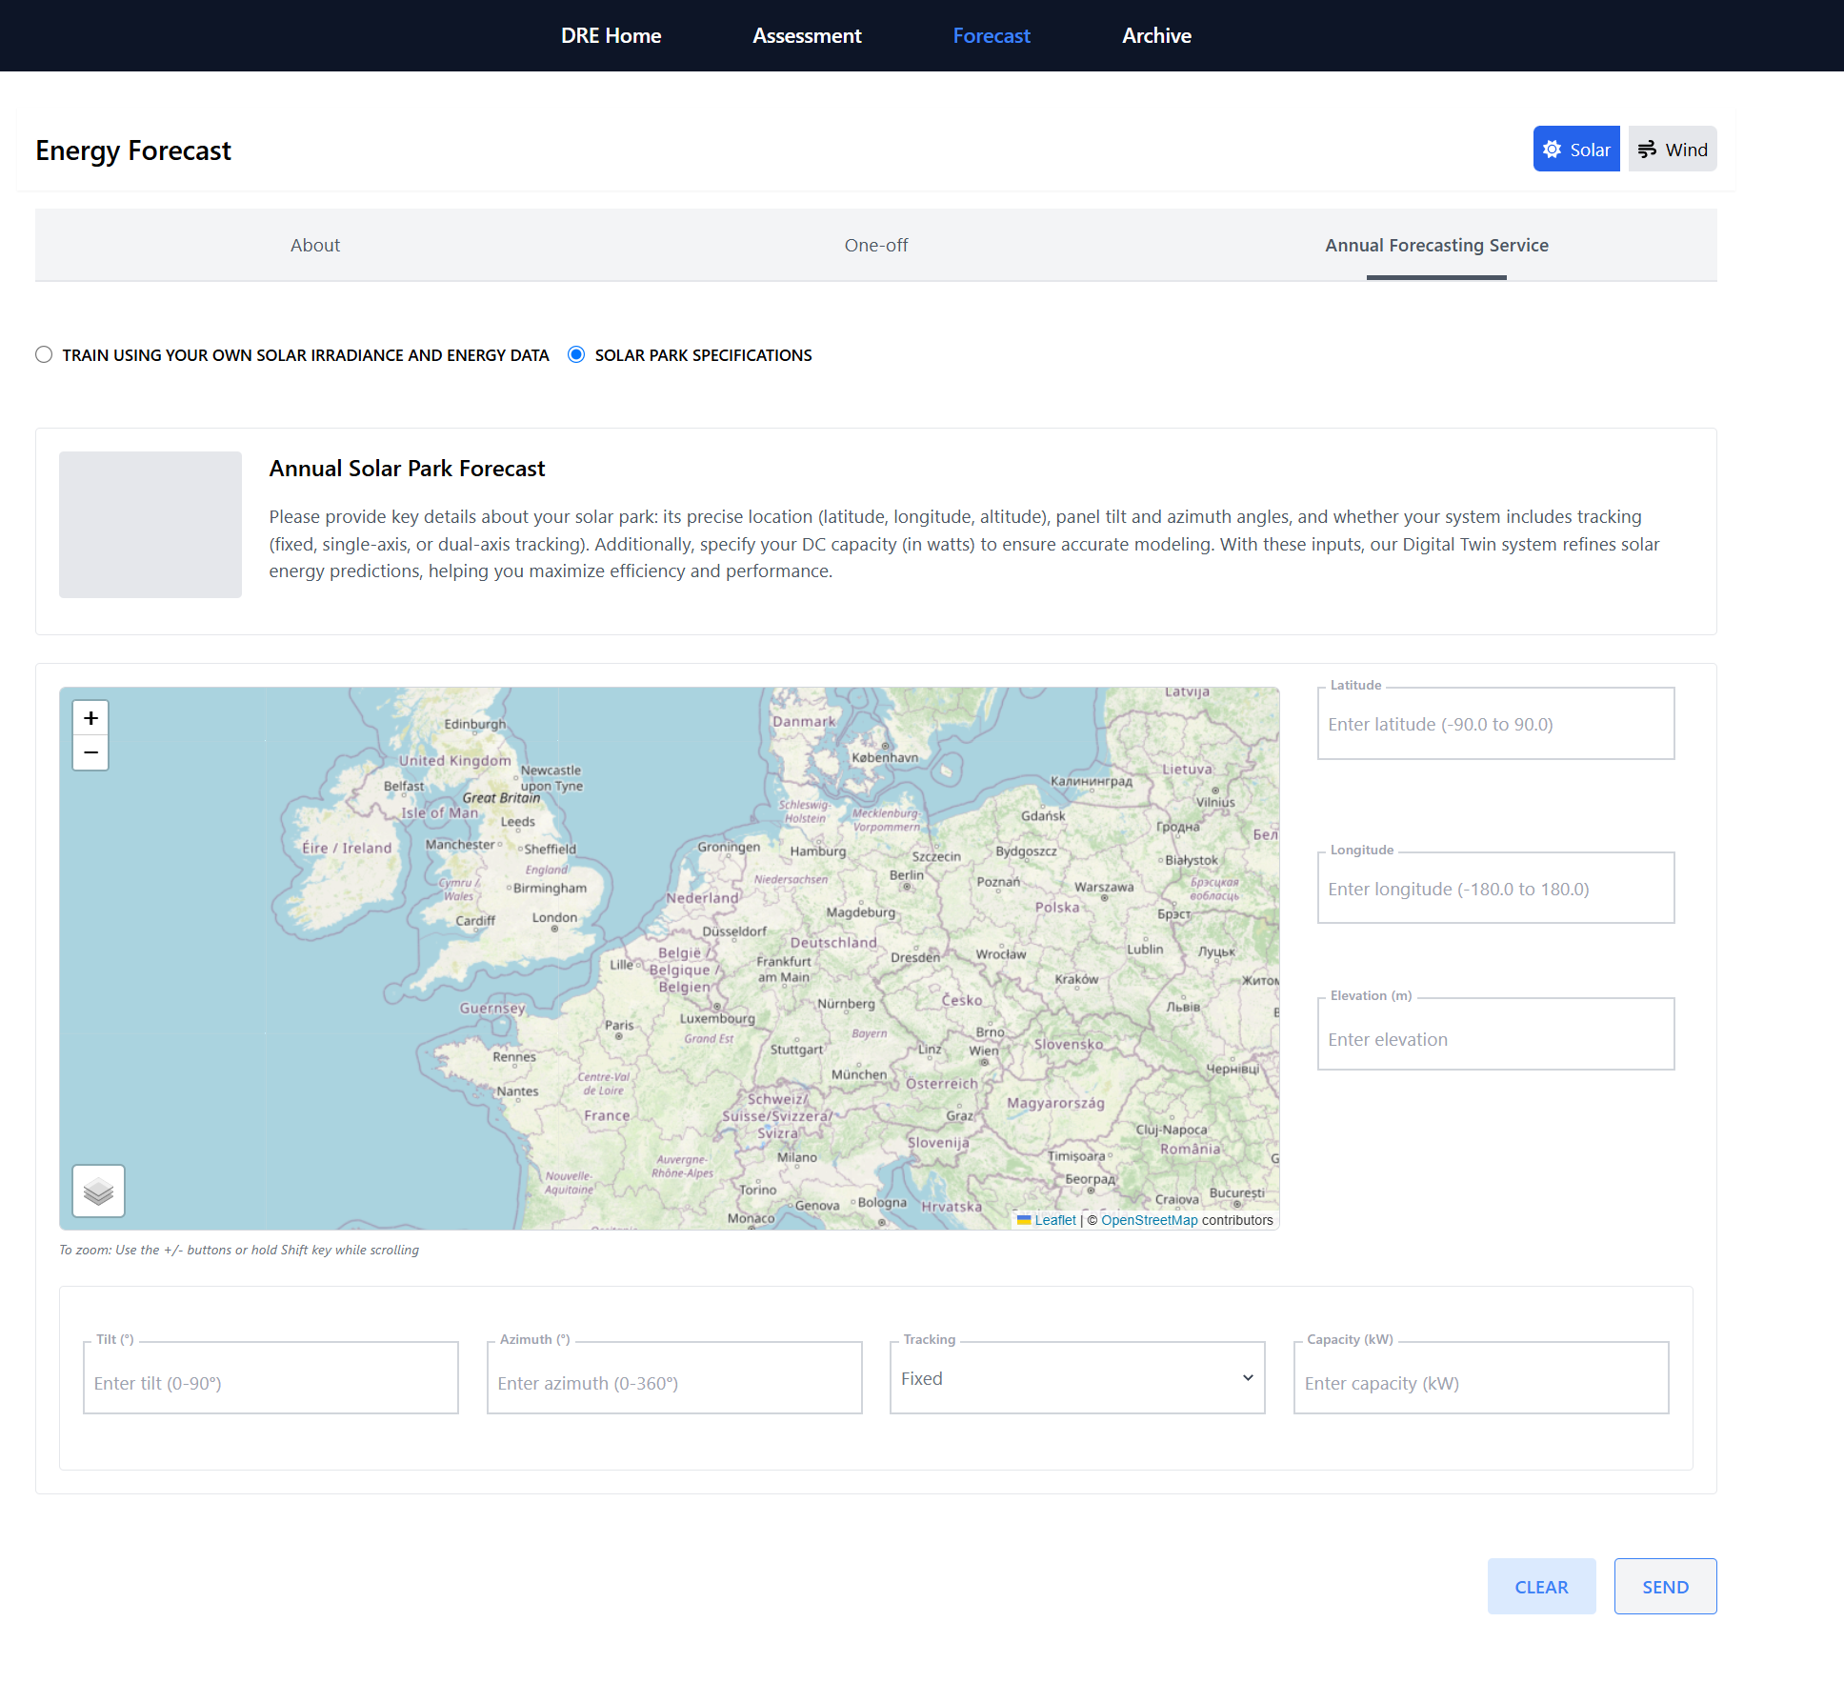
The Annual Solar Park Forecast interface enables users to generate yearly energy predictions by entering specific solar park details. This method uses site characteristics—like location and panel configuration—to simulate energy output.
Users must input the latitude, longitude, and elevation of their site using the right-hand form, with a map provided for spatial reference. Additional inputs include tilt and azimuth angles, as well as the tracking type (fixed, single-axis, or dual-axis) and system capacity in kilowatts. These details help tailor forecasts to the unique conditions of each installation.
Once complete, users can click SEND to submit the forecast request or CLEAR to reset the form.

Slide 13
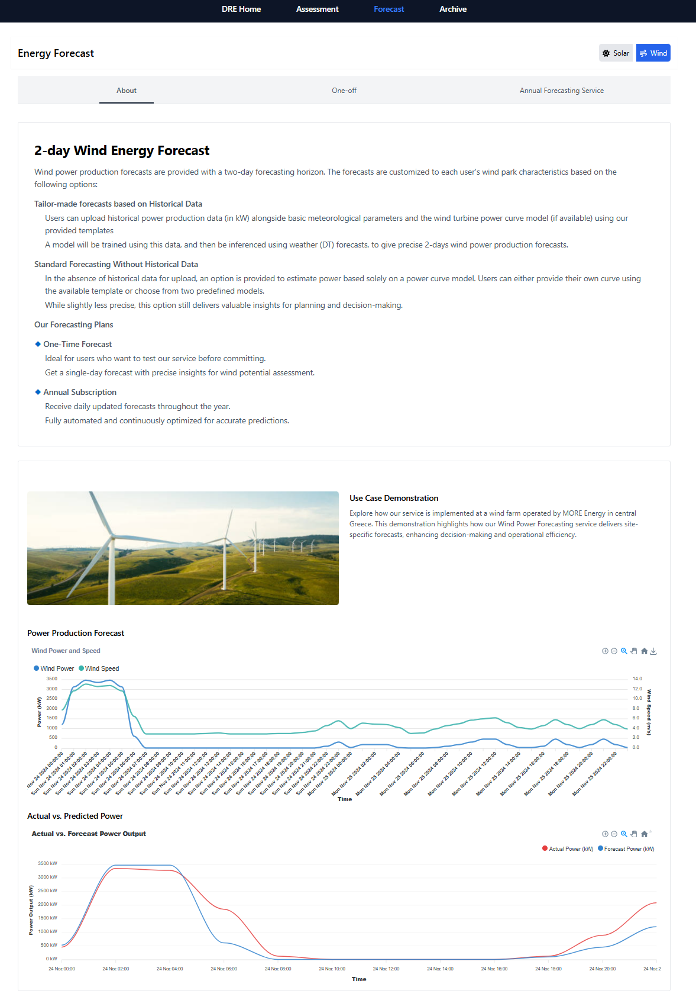
The 2-day Wind Energy Forecast page offers customized wind power forecasts with a 48-hour horizon. Users can either upload historical production data for tailored predictions or opt for standard forecasting using power curve models when no data is available. The system uses meteorological inputs and turbine-specific characteristics to generate accurate forecasts.
Two forecasting plans are available: a One-Time Forecast for short-term trial-based assessments, and an Annual Subscription for daily automated forecasts. Both options support informed planning and operational decision-making.
The interface also includes a use case demonstration from a wind farm in central Greece, showcasing real-world performance. Below this, two graphs visualize the Power Production Forecast (with wind power and speed over time) and Actual vs. Predicted Power to help users evaluate forecast accuracy.

Slide 14
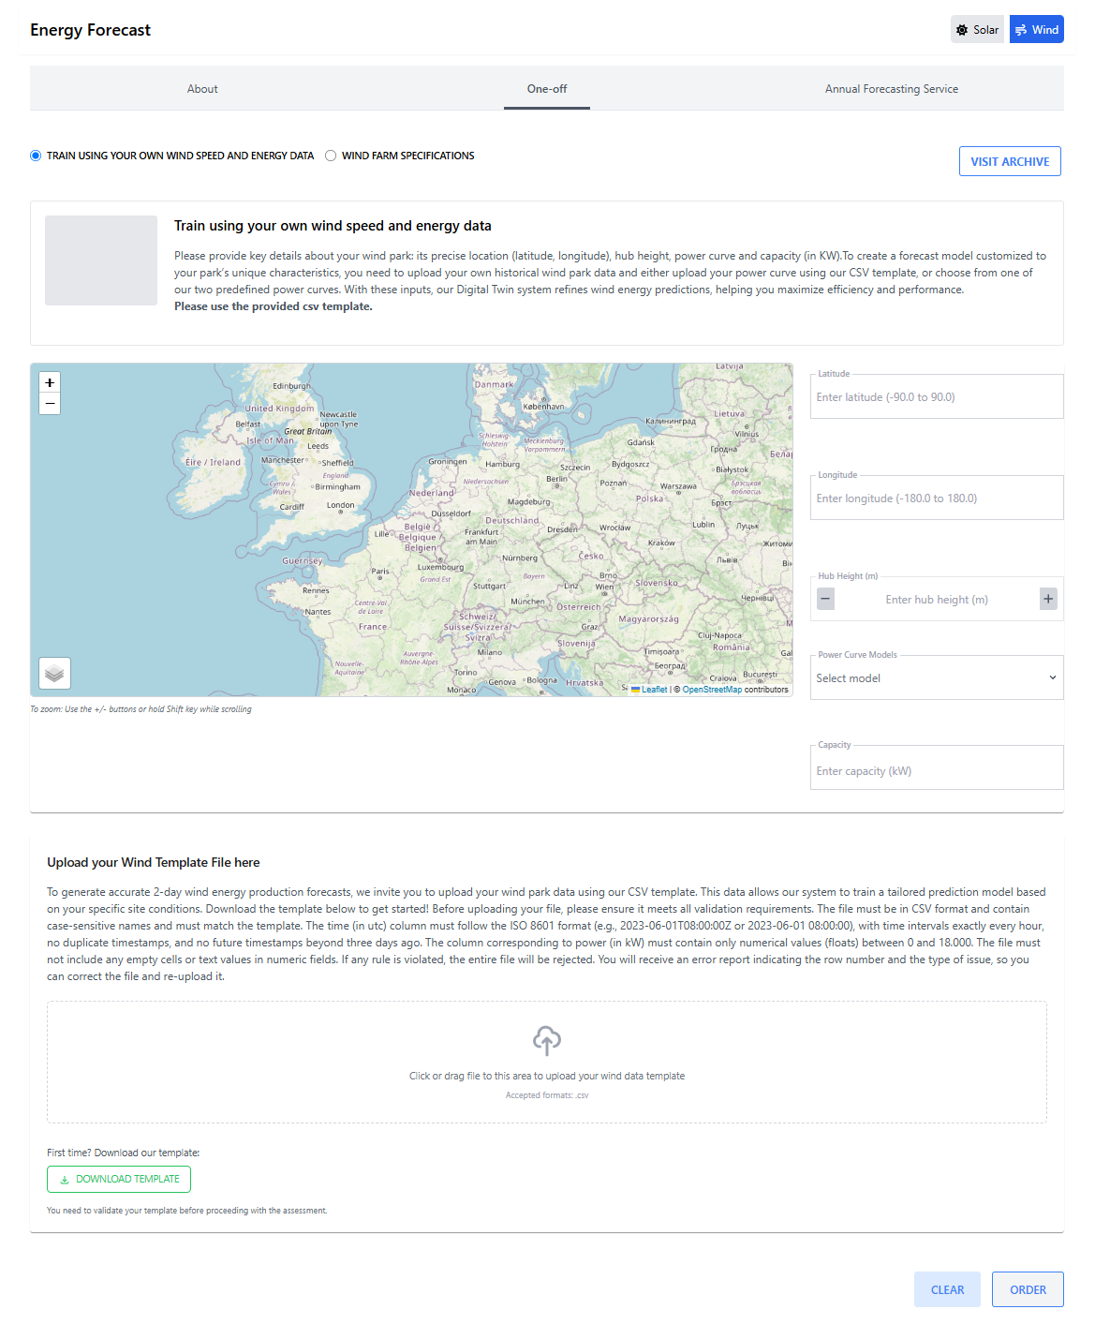
The Train using your own wind speed and energy data interface allows users to generate a one-time wind power forecast based on site-specific measurements. Users can upload wind speed and energy production data in a prescribed CSV format, which is used to train a model for personalized predictions.
To start, users input the latitude, longitude, and hub height of the wind turbine. A dropdown menu is provided for uploading a custom or selecting a predefined power curve model, and users must also enter the system’s capacity in kilowatts. The interactive map assists with verifying the site location.
The Template Upload section at the bottom allows users to drag and drop their .csv file. Tools are included to download and validate the template before proceeding.
Once the data is validated, users can submit their request using the ORDER button or clear the form with CLEAR.

Slide 15
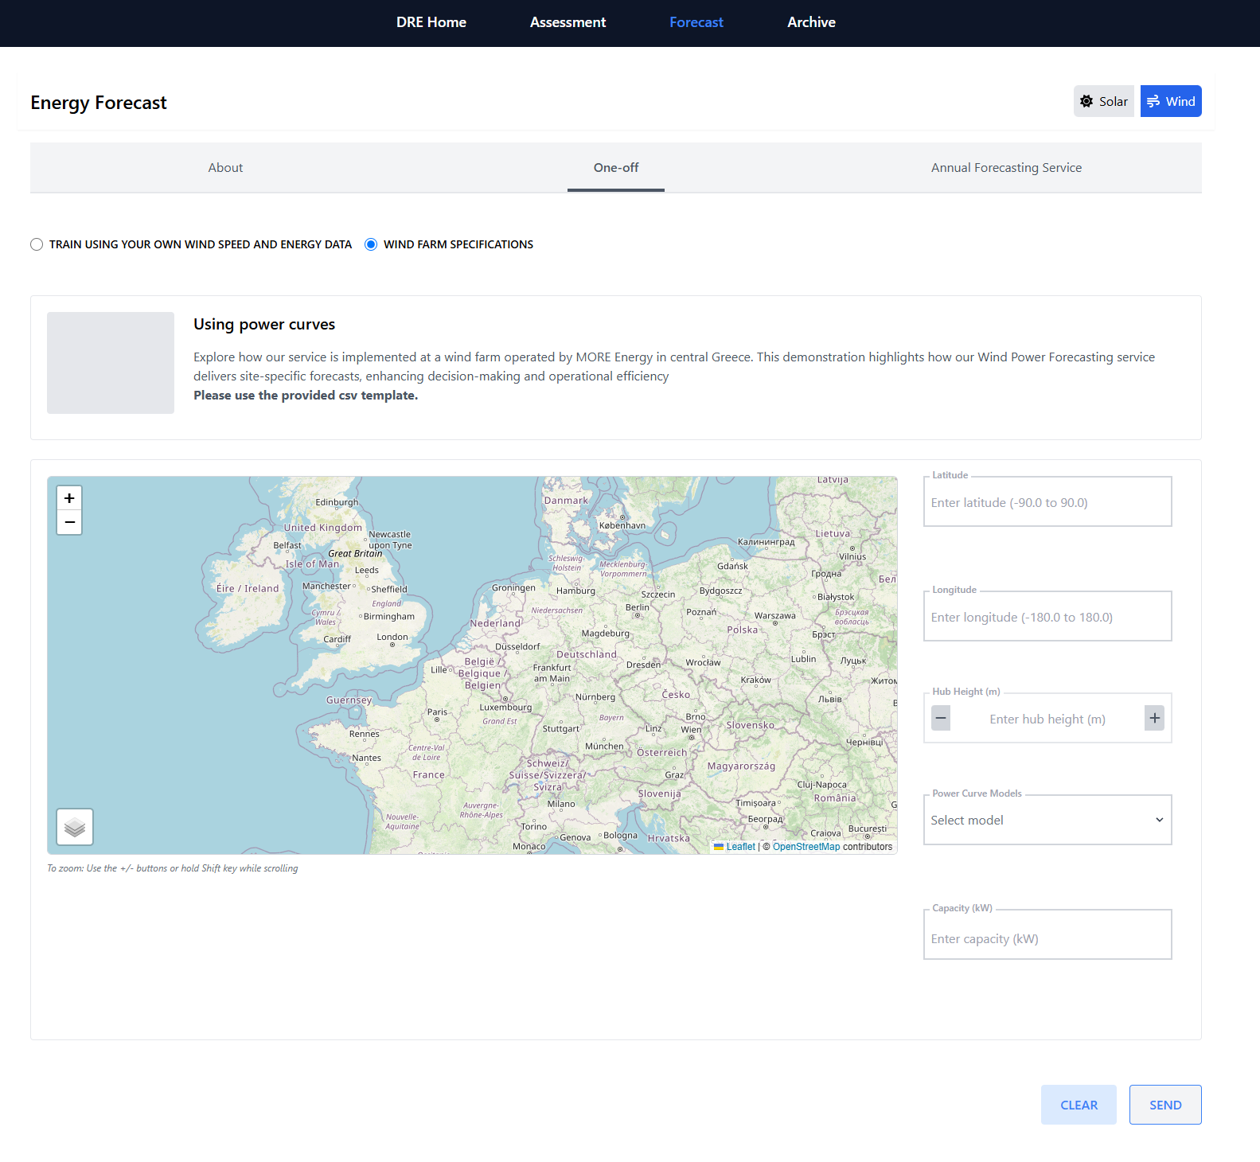
The Wind Farm Specifications interface enables users to generate a one-time wind energy forecast using predefined power curve models instead of historical data. This method is ideal for users who prefer a quick setup while still receiving accurate, site-specific predictions.
Users begin by entering the latitude, longitude, and hub height of their wind turbine. hey must then upload a custom or select a predefined power curve model from the dropdown and specify the turbine’s capacity in kilowatts. The interactive map helps users confirm the accuracy of the site’s location.
Once all fields are completed, users can click SEND to request the forecast or CLEAR to reset the form.

Slide 16
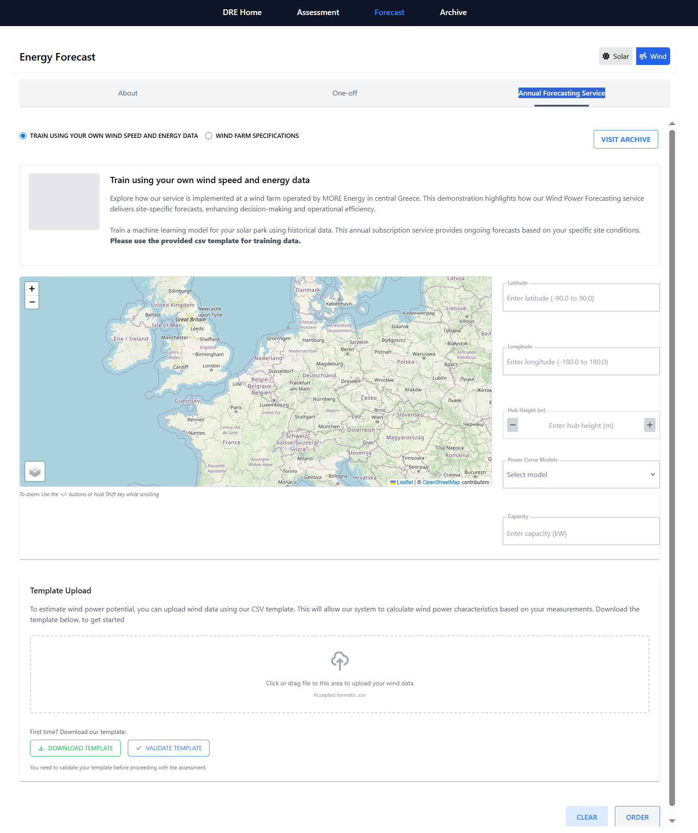
The Annual Forecasting Service allows users to generate continuous wind power forecasts using their own measured data. By uploading historical wind speed and energy production values, users can train a machine learning model tailored to their site. This subscription-based service provides regular updates and enhanced prediction accuracy over time.
Users start by entering their latitude, longitude, and hub height, selecting a power curve model, and specifying the system’s capacity in kilowatts. The interactive map offers a visual aid to confirm the wind farm location.
The Template Upload section enables users to drag and drop a properly formatted CSV file. Tools are provided to download and validate the required template before uploading.
Once ready, the forecast request is submitted using ORDER, while CLEAR resets the form

Slide 17
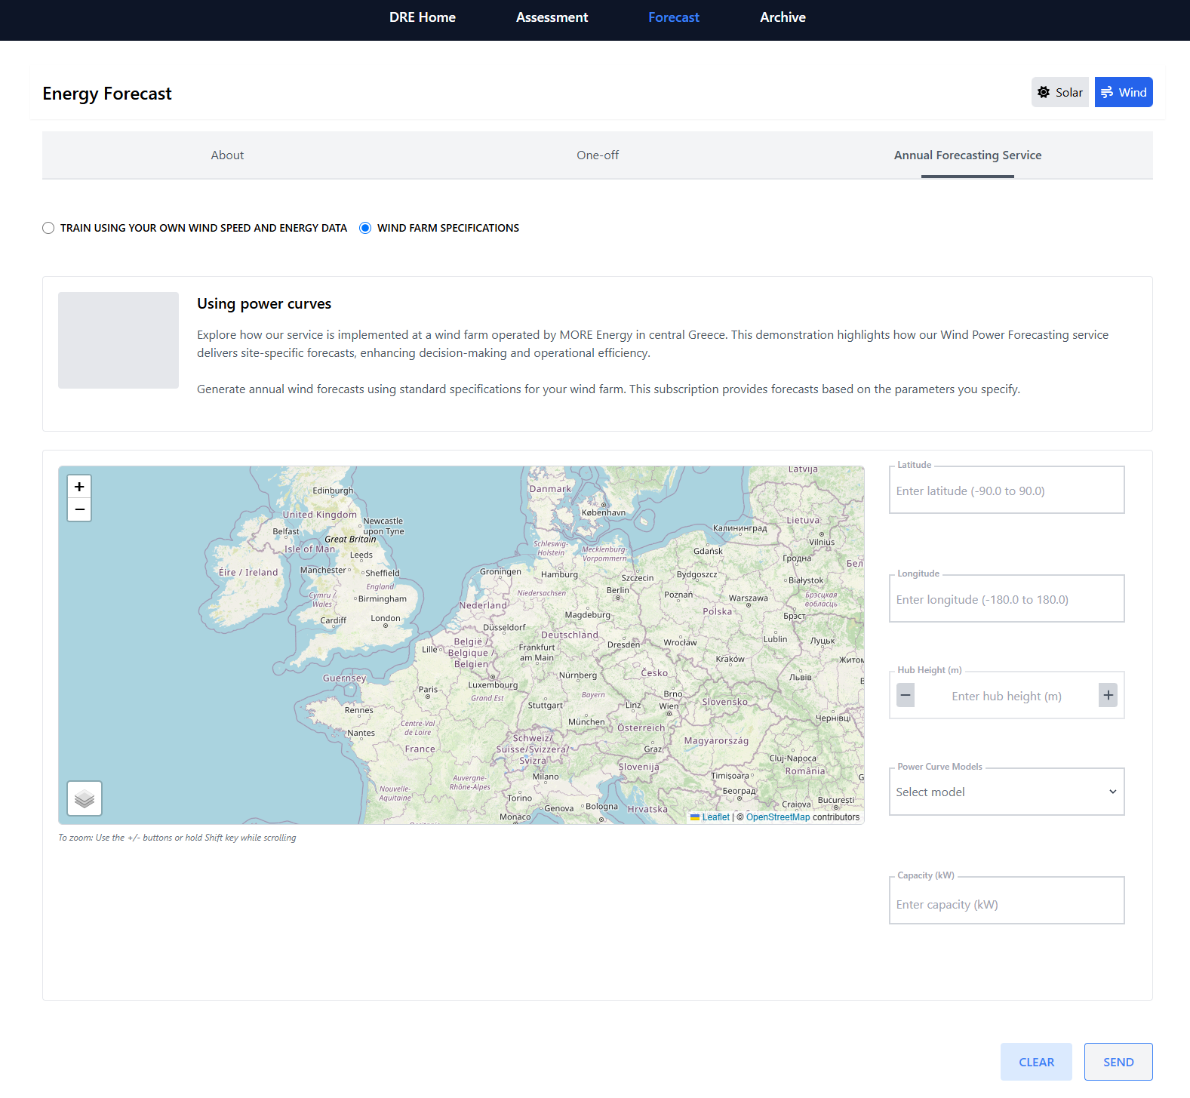
The Wind Farm Specifications interface under the Annual Forecasting Service provides users with continuous, automated wind energy forecasts using predefined turbine parameters. Instead of uploading measurement data, users enter standard configuration values to generate accurate, site-specific predictions year-round.
Key inputs include the wind farm’s latitude, longitude, and hub height. Users must also select a suitable power curve model from the dropdown menu and provide the system’s capacity in kilowatts. The interactive map helps confirm location accuracy.
Once all parameters are filled in, users can click SEND to submit the forecast request or use CLEAR to reset the form. This option is ideal for users looking for streamlined, subscription-based wind forecasting without historical data input.

Slide 18
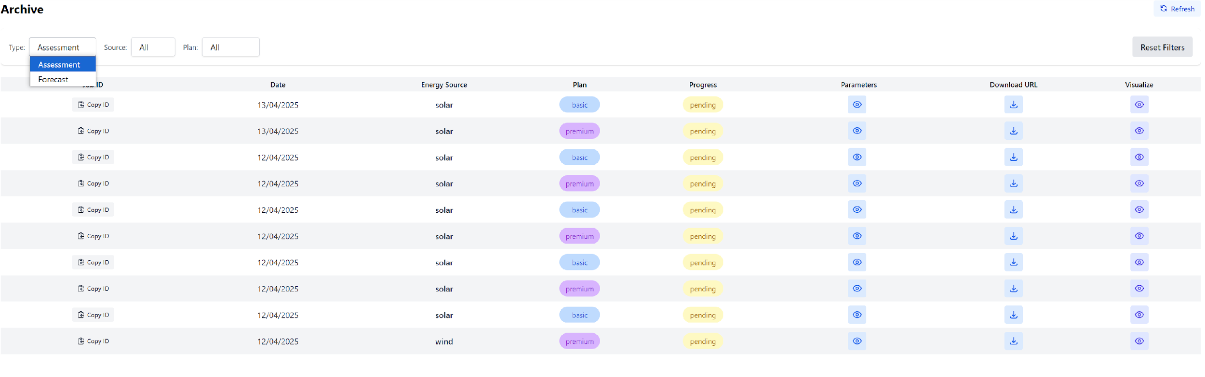
Use filters at the top to quickly find specific jobs (e.g., all wind jobs with premium plan).
This dashboard helps track and manage assessment and forecast jobs by type, energy source, plan, and status.
Always click Refresh after launching the dashboard to ensure the latest data is loaded.
Click the icon to Download the data generated by the request.
Use Copy ID when needing to share or reference a job.
Use Parameters to visualize the configuration of your job request
Use Visualize to check the analytical or visual representation without downloading the raw files.

